Slide 1
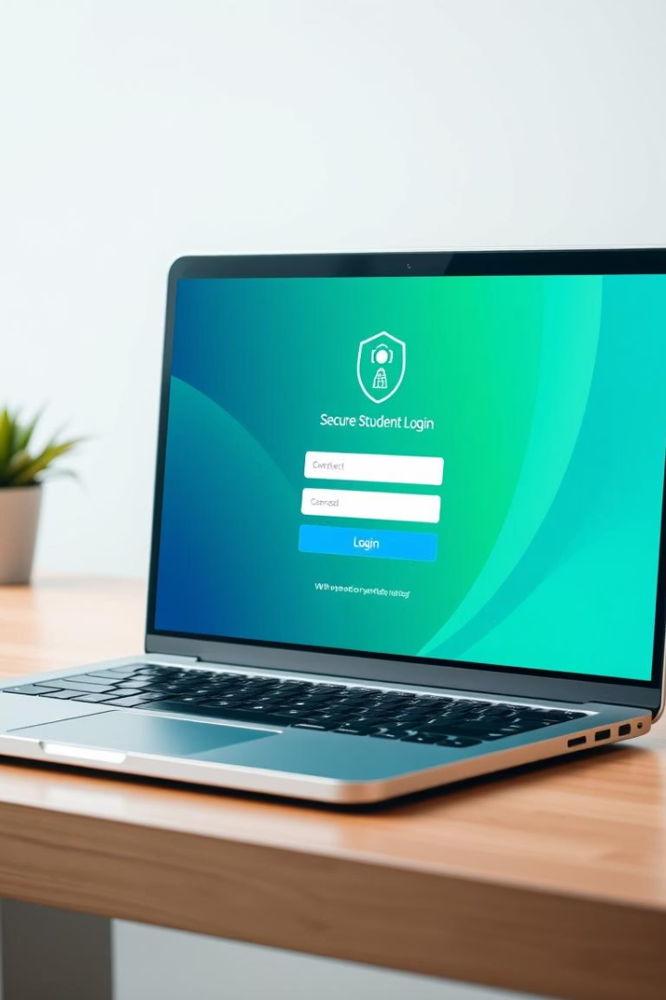
Student Exam Database Login System
Exploring a secure, efficient login system for managing student exam data.

Slide 2

Problem Statement
Issues
Data Integrity
Difficulty securely accessing exam data
Prevent unauthorized access and data tampering
Usability
Simple, user-friendly login experience needed

Slide 3
Technology Used
Backend
Frontend
Security
Node.js with Express framework
React for responsive UI
JWT for authentication
MySQL for database storage
Bootstrap CSS for design
Encrypted password storage

Slide 4
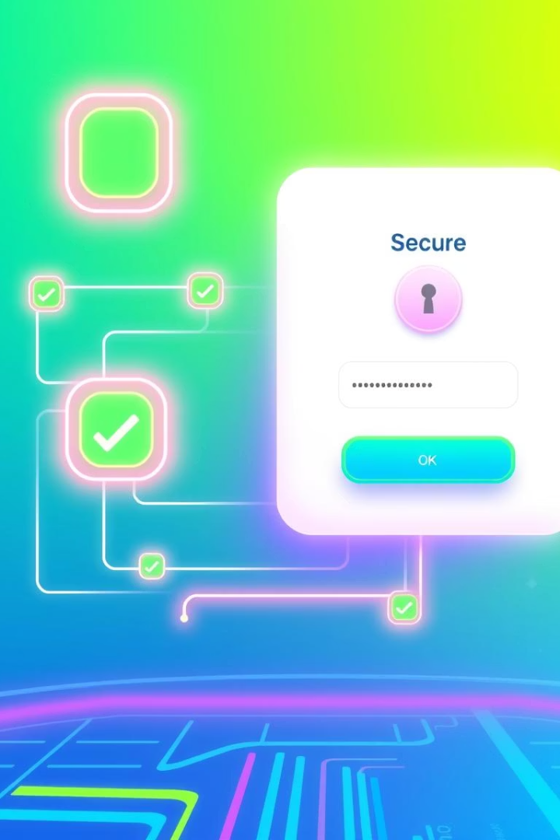
Wow Factor
Robust Security
Smooth UX
Multi-factor authentication and encryption
Fast, intuitive login with instant feedback
Scalable Design
Handles large student datasets efficiently

Slide 5
End Users
Students
Teachers
Administrators
Access personalized exam results securely
Manage exam data and verify logins
Oversee database security and maintenance

Slide 6

Results
The system improved reliability and eliminated unauthorized access.

Slide 7

Conclusion & GitHub Link
Conclusion
GitHub Repository
System meets security and usability goals effectively

Slide 8




Future Scope
Biometric Authentication
Implement face and fingerprint login
Mobile App Integration
Offer seamless login on mobile devices
Analytics Dashboard
Provide usage insights and system monitoring

